Slide 1
Managing Media
Digitization Workflows
Mike Casey, Director of Technical Operations, Media Digitization and Preservation Initiative, Indiana University
Andrew Dapuzzo, Director of North American Operations, Memnon Archiving Services

Slide 2
Manage…
administer
conduct
govern
guide
handle
maintain
operate
oversee
regulate
run
supervise
take care of
train
use
advocate
captain
counsel
designate
direct
disperse
engineer
execute
head
influence
instruct
minister
officiate
pilot
ply
preside
request
steer
superintend
watch
care for
carry-on
engage in

Slide 3
Indiana University Media Digitization and Preservation Initiative (MDPI) Overview
Digitally preserve all significant audio and video
Complete by IU Bicentennial in 2020
University-wide initiative

Slide 4
MDPI Digitization Strategy
Sony Memnon – parallel transfer (industrial-scale) workflows
IU – 1:1 workflows for fragile formats and problem items
Digitally preserve approximately 280,000 audio and video recordings
Digitized 141,198 as of last Friday
6.5 PB in 4 years

Slide 5
IU Media Digitization Studios
Audio preservation
7,000 field cylinders, lacquer discs, mixed speed tapes, wire recordings
Sound Directions 1:1 workflow

Slide 6
IU Media Digitization Studios
Video preservation
Hi 8/8mm, Betamax, ½” EIAJ
Problem VHS, Umatic, Betacam SP

Slide 7
IU Media Digitization Studios
Productivity
Systems thinking
Theory of Constraints principles
Scrum methodology
Scripts

Slide 8
General Systems Theory

Slide 9
General Systems Theory
Theory created in the 1930s in which complex systems are viewed holistically
Way of thinking
Aid evaluation of media preservation system design, effectiveness, sustainability, completeness, and behavior

Slide 10
Theory of Constraints

Slide 11
Theory of Constraints
Overview
Developed by Dr. Eliyahu Goldratt in the early 1980s
Methodology for identifying the most important limiting factor that stands in the way of achieving a goal
Improve constraint until it is no longer a limiting factor

Slide 12
Theory of Constraints
Overview– define terms
Constraint is a limitation or restriction
Constraint = bottleneck
Bottleneck = stage in a process where progress is impeded, “weakest link in the chain”
Throughput is the quantity of raw material processed within a given time

Slide 13
Theory of Constraints
Overview
Every process (workflow) has a constraint
Throughput is governed by how much can be run through the constraint per period of time
Throughput improves when constraint improves
Improving a non-bottleneck does not make the workflow more productive

Slide 14
Theory of Constraints
Five focusing steps
Identify – find the bottleneck
Exploit – quick improvements using existing resources
Subordinate –everything else must support the above
Elevate – further actions to eliminate bottleneck – may include capital investment
Repeat – continuous improvement cycle

Slide 15
Typical audiotape digitization workflow
Manager assigns work
Engineer
Inspects tape
Winds tape
Checks and repairs splices
Repairs pack problems
Gathers technical metadata
Engineer digitizes

Slide 16
Theory of Constraints
Where is the bottleneck in our system?
Workflow step with capacity equal to or less than the demand placed on it

Slide 17
Theory of Constraints
Exploit and elevate
Offload tasks from the bottleneck and place elsewhere
Place QC before the bottleneck

Slide 18
New digitization workflow
Manager assigns work
AV Specialist
Inspects tape
Winds tape
Checks and repairs splices
Repairs pack problems
Gathers technical metadata
Engineer digitizes

Slide 19
New digitization workflow
Manager assigns work
Engineer digitizes
AV Specialist
Inspects tape
Winds tape
Checks and repairs splices
Repairs pack problems
Gathers technical metadata
Engineer digitizes

Slide 20
Theory of Constraints
Exploit and elevate
Offload tasks from the bottleneck and place elsewhere – AV Specialist
Place QC before the bottleneck– AV Specialist
Create inventory buffer before bottleneck
Keep the bottleneck working as much as possible
If bottleneck is idle for an hour, lose the cost of an hour for entire system
An hour saved at a non-bottleneck is a mirage

Slide 21
Management of Digitization Workflow
How can we –
Support choice
Foster investment and engagement
Keep morale high
Track which recordings should be digitized next

Slide 22
Scrum

Slide 23
Management of Digitization Workflow
Scrum methodology
Part of the Agile software development movement
Emphasizes collaboration, team self-management, and flexibility to adapt to emerging realities

Slide 24
Management of Digitization Workflow
Scrum methodology characteristics
Time is divided into short work cadences known as sprints
Two week sprints
Evaluate and plan next steps at end of sprint
Daily meetings to assess progress (standups)

Slide 25
Management of Digitization Workflow
Scrum methodology
Enter backlog into Jira
Divide recordings into groups based on technical characteristics
Engineers select groups to commit to for sprint
Story points = duration of group (minutes)

Slide 26
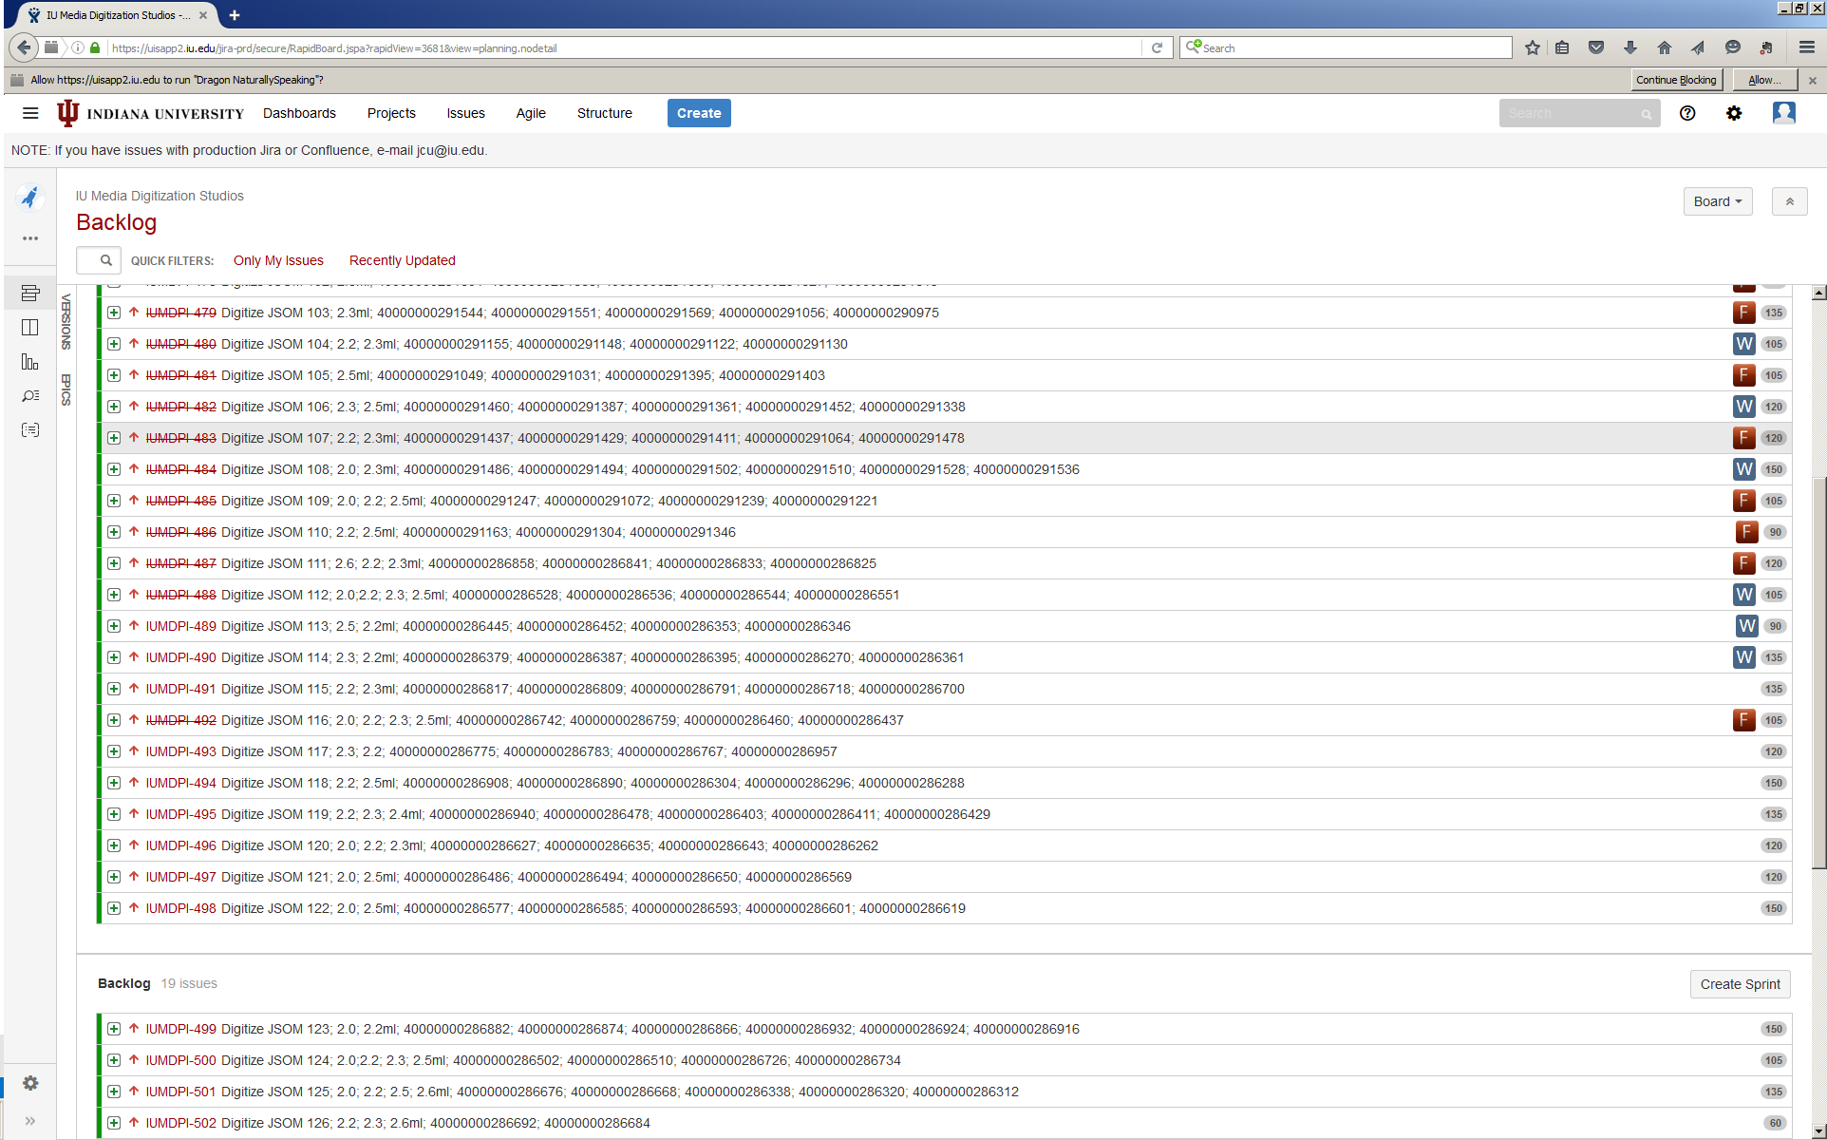

Slide 27
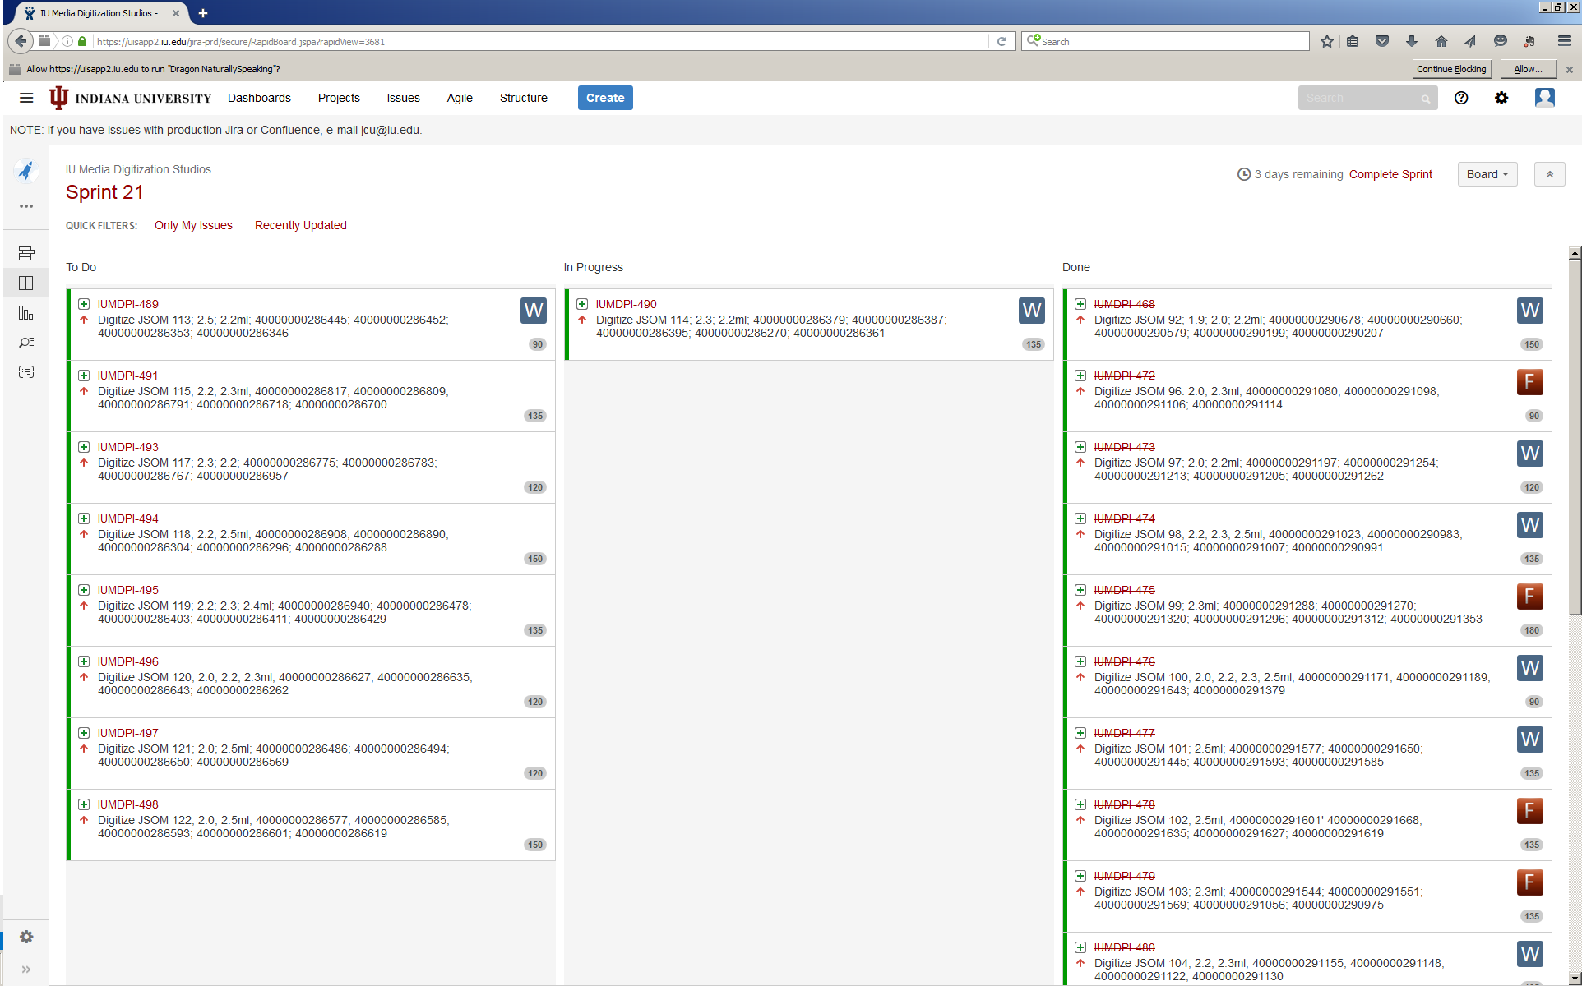

Slide 28
Management of Digitization Workflow
Scrum methodology
Built-in frequent feedback loops for both technical staff and administration
Always know where things stand
Supports philosophy of constant improvement
Focus on two-week commitments not endless future
Engineers have choice

Slide 29
New digitization workflow
Manager assigns collection
Engineer chooses recordings
Engineer digitizes
AV Specialist
Inspects tape
Winds tape
Checks and repairs splices
Repairs pack problems
Gathers technical metadata
Engineer digitizes

Slide 30
Software Automation

Slide 31
Managing Media
Digitization Workflows
Mike Casey, Director of Technical Operations, Media Digitization and Preservation Initiative, Indiana University
Andrew Dapuzzo, Director of North American Operations, Memnon Archiving Services

