Slide 1
Media Preservation at Scale:
The Indiana University Media Digitization and Preservation Initiative
Mike Casey, Director of Technical Operations, MDPI, Indiana University
Andrew Dapuzzo, Director of US Operations, Memnon Archiving Services

Slide 2
MDPI Goal:
Digitally preserve 280,000 audio and video recordings in 3-4 years
Progress:
94,959+ digitized as of yesterday

Slide 3
1990s– Variations Digital Music Library
1998 – Digital Library Program formed
2000 – mass storage system implemented
2001 – EVIA digital video archive begun
2005-2012 – NEH-funded Sound Directions grants
2006 –IMLS-funded Digital Audio Archives Project
2009 – IU Libraries moving image archive founded

Slide 4
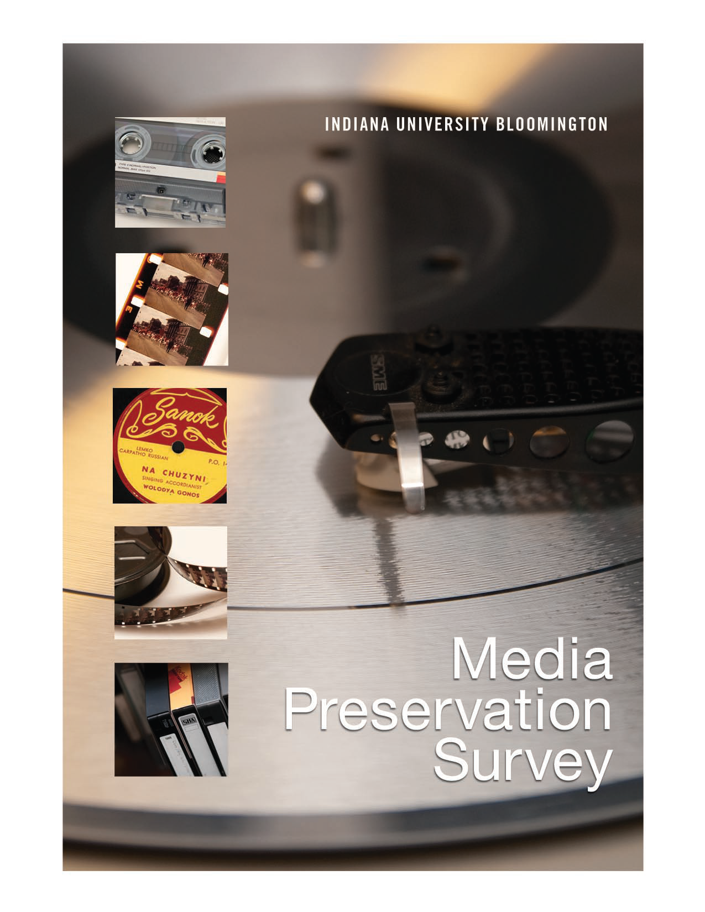

Slide 5
Lesson 1
Highlight research and instructional value
(along with Degralescence)

Slide 6
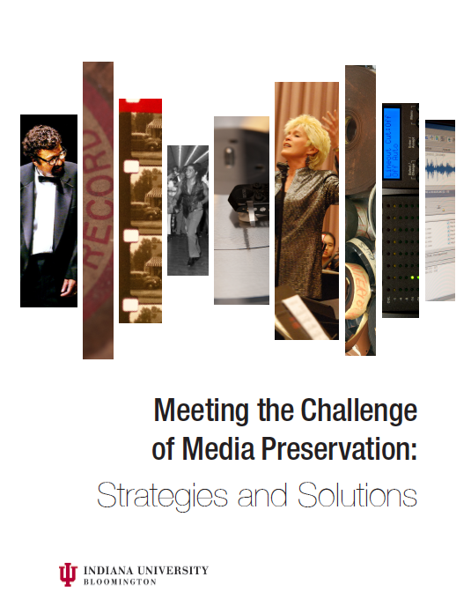

Slide 7
Lesson 2
Preserverance
(Preservation perseverance)

Slide 8
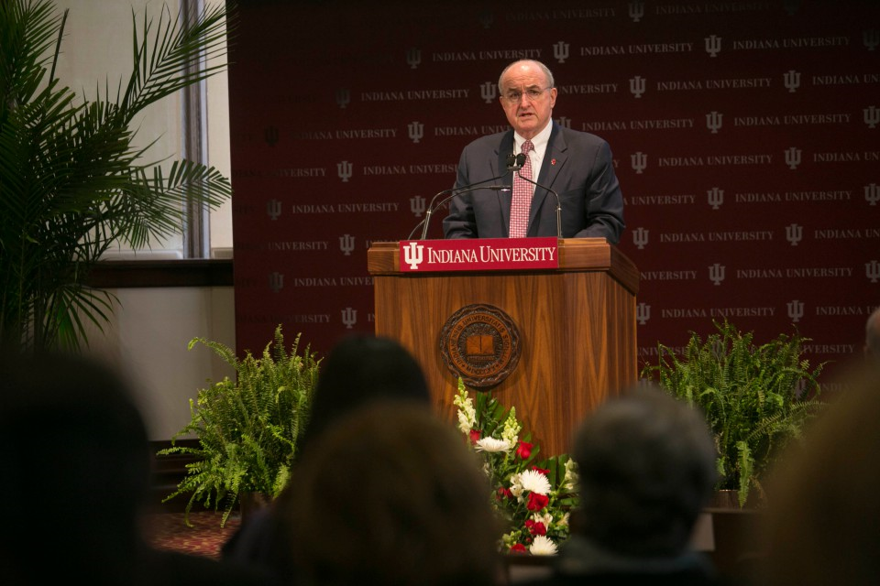
2013 State of the University Announcement
Media Digitization and Preservation Initiative (MDPI)

Slide 9
MDPI Overview
Digitally preserve all significant audio and video
Complete by IU Bicentennial in 2020
University-wide initiative

Slide 10
MDPI Funding
Office of the President
Office of the Provost
Office of the Vice President for Research
Additional funding and in-kind support: UITS, Libraries

Slide 11
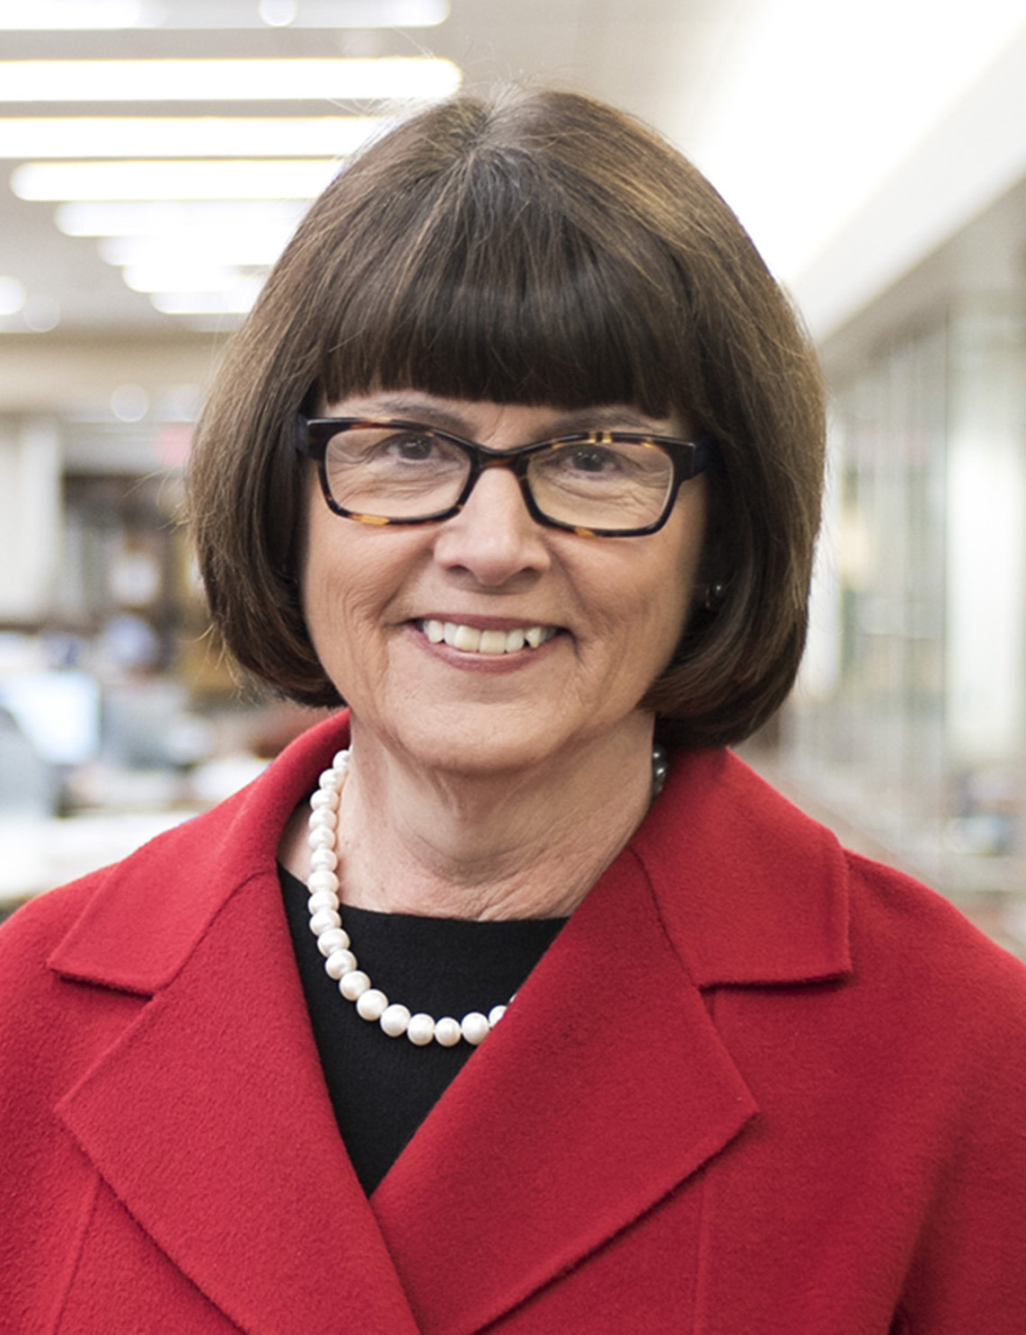
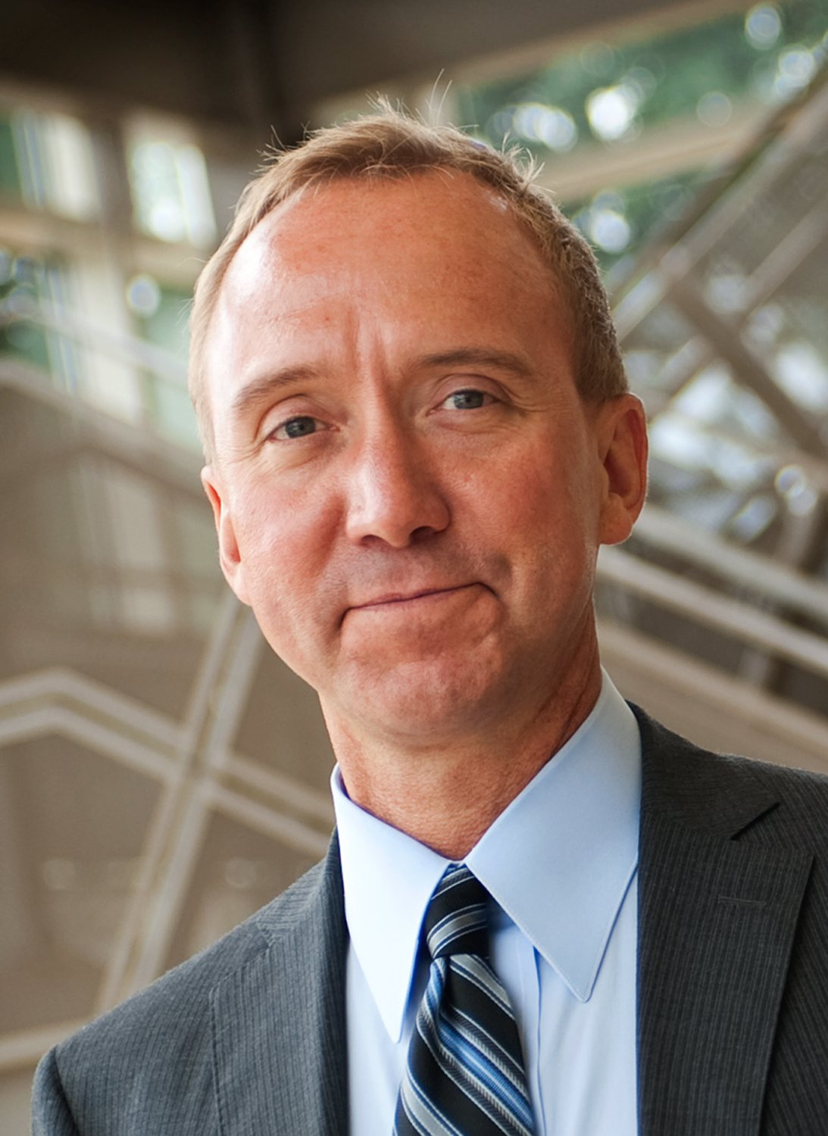
MDPI Leadership
MDPI Co-Chairs
MDPI Executive Director
Carolyn Walters
Ruth Lilly Dean of University Libraries
Brad Wheeler
Vice President for Information Technology and Chief Information Officer
Laurie G. Antolovic’
Associate Vice President and Deputy Chief Information Officer

Slide 12
MDPI Personnel
Management and Coordination
Mike Casey, MDPI Director of Technical Operations
Brian McGough, Director, Enterprise Integration, UITS
Julie Bobay, Executive Associate Dean, Libraries

Slide 13
MDPI Personnel
IU Media Digitization Studios staff
Mike Casey
Melissa Widzinski, Audio Engineer
Dan Figurelli, Audio Engineer
Rob Mobley, Video Engineer
Susan Hooyenga, QC Specialist
Glenn Hicks, QC Specialist
Jonathan Richardson, AV Tech

Slide 14
MDPI Personnel
Strategic Media Access Resource Team (SMART)
Patrick Feaster, Media Preservation Specialist
6-8 graduate students

Slide 15
MDPI Personnel
Software Development
Brent Moberly
Andrew Albrecht
Adam Ploshay
Will Cowan
Sherri Michaels
Brian Wheeler
Patrick Feaster
Brian McGough

Slide 16
MDPI Personnel
Library and IU Units Operations Team
Julie Hardesty
Thomas Whitaker
Erika Dowell
Gary Charbonneau
Alan Burdette
Phil Ponella
Tony Tadey
Jon Dunn
10 others previously named above

Slide 17
MDPI Personnel
IT Team
Kurt Siefert
David Hunter
Kristi Kallback-Rose
Danko Antolovic’
John Wright
Brian McGough

Slide 18
MDPI Personnel
IT Communications
Keith Danielson
Alan Mauro
Amanda Chambliss
Joe Stone
Ralph Zuzolo
Brian Hawkins
Madeline Grdina
Daphne Siefert-Herron

Slide 19
MDPI Personnel
Finance, facilities, and administrative assistance
Misty Smith
Doug Mayo
Heather Pawluk
Don Brock
Doug Chambers
Chris Hayden

Slide 20
MDPI Personnel
SIP Working Group
Ronda Sewald
Julie Hardesty
Susan Hooyenga
Brian Wheeler
Brian McGough
Jon Dunn

Slide 21
MDPI Personnel
Access Advisory Working Group
Naz Pantaloni
Dina Kellams
Barbara Truesdell
Heidi Dowding
Nick Homenda
Rachael Stoeltje
13 others previously named above

Slide 22
MDPI Personnel
Media-holding Unit Staff
Numerous staff from many units

Slide 23
MDPI Personnel
Audio and Video Technical Working Groups
Konrad Strauss
Mark Hood
Tony Tadey
John Wright

Slide 24
MDPI Personnel
Consultant
AVPreserve
Colleagues
Michael Angeletti, Stanford University
Chris Lacinak, AVPreserve
Dave Rice, CUNY
Library of Congress Packard campus
Danny Sbardella, New York Public Library
National Library of Norway
NARA
Tom de Smet, Sound & Vision
Brecht Declercq, VIAA
Many others…

Slide 25
Lesson 3
It takes a village…

Slide 26
MDPI Digitization Strategy
Paradigm shift: explore partnership with a private company
Partnership with Memnon Archiving Services
Key to realizing goals around cost and timeframe without sacrificing quality

Slide 27
MDPI Digitization Strategy
Memnon – parallel transfer (industrial-scale) workflows
IU – 1:1 workflows for fragile formats and problem items
6.5 PB in 4 years

Slide 28
Lesson 4
We don’t have to do it all ourselves

Slide 29
MDPI Digitization Strategy - Audio

Slide 30
MDPI Digitization Strategy - Video

Slide 31
MDPI Digitization Strategy
Project file formats
Audio preservation master – BWF, 24/96
Audio production master – same
Video preservation master –
FFV1/Matroska
Video mezzanine – 50 Mbps MPEG-2

Slide 32
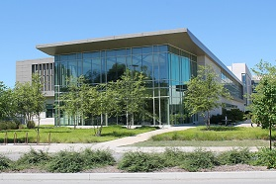
MDPI Digitization Facility
Innovation Center, Tech Park, IU Bloomington campus
Renovation December 2014 – May 2015
8,400 square feet (780 sq m)
21 rooms

Slide 33
MDPI Pre-Digitization Workflow
Feeding the beast
At peak –
9 TB per day
320 hours digitized per day
616 physical objects digitized per day
2,700 files created per day

Slide 34
MDPI Pre-Digitization Workflow
SMART – led by Patrick Feaster
Sort by technical characteristics
Gather technical metadata
Barcode
Place in batch
Transport to facility

Slide 35
IUB units with media
African American Arts Institute
African Studies Program
Anthropology, Department of
Archaeology, Glenn Black Laboratory of
Archives of African American Music and Culture
Archives of Traditional Music
Art Museum
Astronomy, Department of
Bands, Department of (Jacobs School of Music)
Basketball, Men's (Athletics Dept.)
Basketball, Women's (Athletics Dept.)
Black Film Center Archive
Business/SPEA Information Commons (IUBL)
Center for Disability Information and Referral
Center for Language Technology and Instructional Enrichment
Center for Languages of the Central Asian Region
Center for Latin American and Caribbean Studies
Center for the Documentation of Endangered Languages
Center for the Integrative Study of Animal Behavior
Center for the Study of Global Change
Center for the Study of History and Memory
Center on Aging and Community
Central Eurasian Studies
Chemistry Library (IUBL)
Communication and Culture, Department of
Creole Institute
East Asian Studies Center
Education Library (IUBL)
Elizabeth Sage Historic Costume Collection
Eppley Institute for Parks and Public Lands
Field Hockey (Athletics Dept.)
Fine Arts Library (IUBL)
Folklore and Ethnomusicology, Department of
Football (Athletics Dept.)
Gay, Lesbian, Bisexual and Transgender Student Support Services Library
Geography and Map Library (IUBL)
Geology Library (IUBL)
Golf (Athletics Dept.)
Government Information, Microforms, and Statistical Services (IUBL)
Health, Physical Education, and Recreation (HPER) Library (IUBL)
I. U. Foundation
Indiana Prevention Resource Center
Inner Asian and Uralic National Resource Center
Institute for Advanced Study
Kinsey Institute for Research in Sex, Gender, and Reproduction
Latin American Music Center
Latino Cultural Center (La Casa)
Law Library
Liberian Collections Project
Life Sciences Library (IUBL)
Lilly Library (IUBL)
Linguistics Club
Mathers Museum of World Cultures
Media and Reserve Services (IUBL)
Media Design and Production
Modern Political Papers (IUBL)
Music Library, William and Gayle Cook
Neal-Marshall Black Culture Center Library (IUBL)
Optometry Library (IUBL)
Optometry, School of
Polish Studies Center
Psychological and Brain Sciences, Department of
Radio and Television Services
Recording Arts, Department of (Jacobs School of Music)
Residential Programs and Services Libraries
Rowing (Athletics Dept.)
Roy W. Howard Archive
Russian and East European Institute
Soccer, Men's (Athletics Dept.)
Softball (Athletics Dept.)
Sound And Video Analysis & Instruction Laboratory
Swain Hall Library (IUBL)
Tennis, Men's (Athletics Dept.)
Theatre and Drama, Department of
Traditional Arts Indiana
Unclaimed Collection #2 (Franklin Hall Attic)
University Archives (IUBL)
University Communications, Office of
Video Production (Athletics Dept.)
Volleyball, Women's (Athletics Dept.)
West European Studies Film Library

Slide 36
Lesson 5
Prep workflow requires significantly more time and resources than expected
Bottleneck in the system

Slide 39
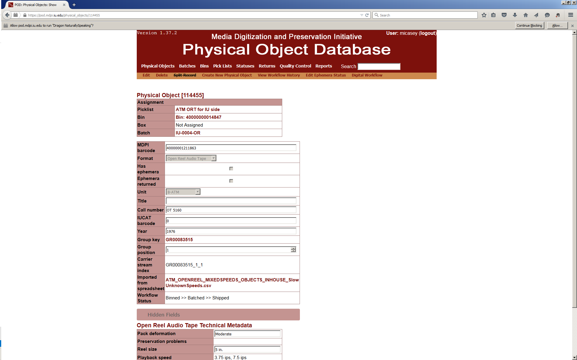

Slide 40
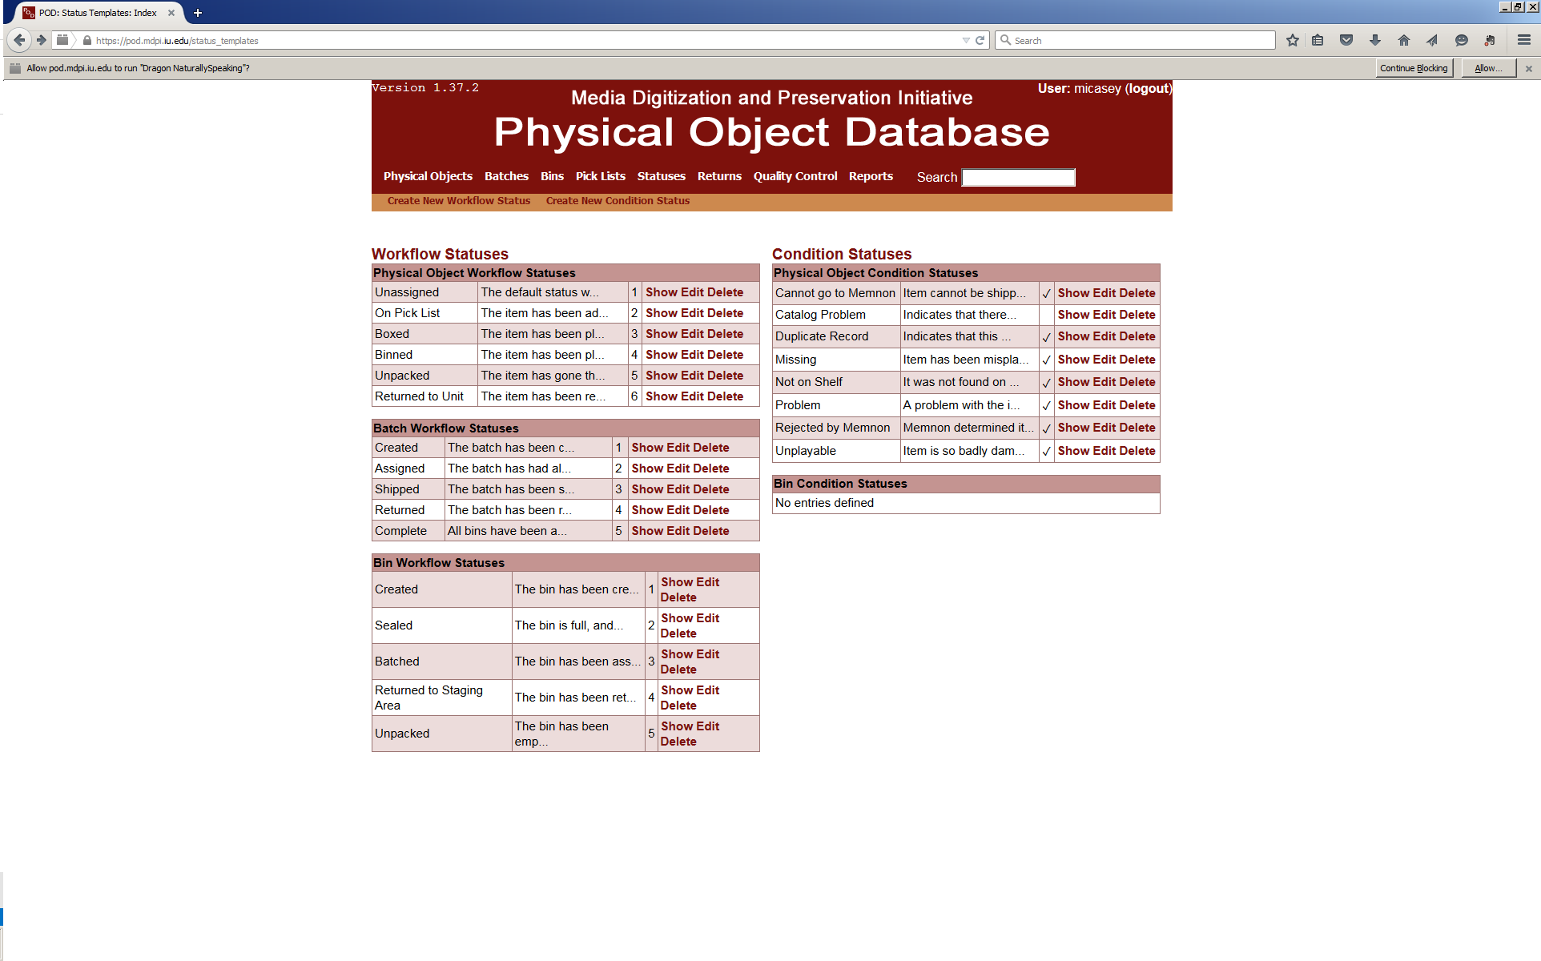

Slide 41
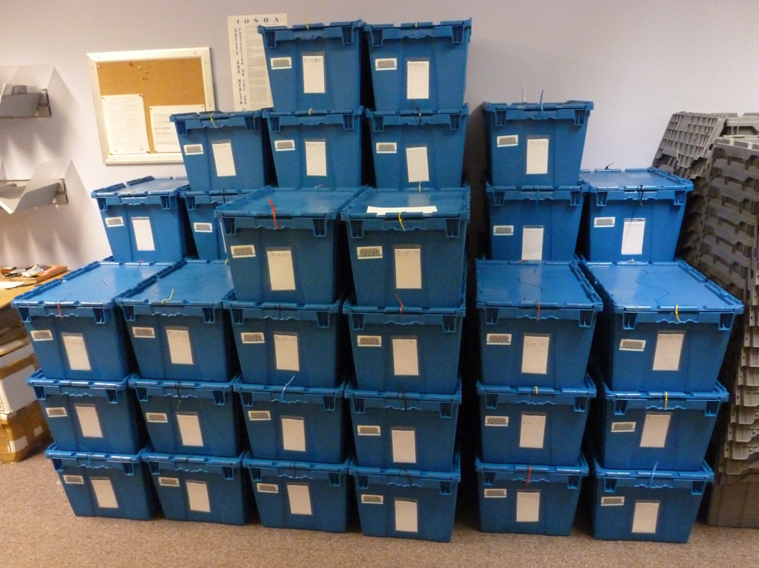
One batch

Slide 42
IU Media Digitization Studios
Audio preservation
7,000 field cylinders, lacquer discs, mixed speed tapes, wire recordings
Sound Directions 1:1 workflow
Two critical listening rooms designed by Jeff Hedback

Slide 43
IU Media Digitization Studios
Video preservation
Hi 8/8mm, Betamax, ½” EIAJ
Problem VHS, Umatic, Betacam SP
FFmpeg, home-grown interface
Blackmagic card

Slide 44
IU Media Digitization Studios
Productivity
Applying Theory of Constraints principles
Elevating the bottlenecks
AV Tech position
Scripts
Scrum methodology
Jira backlog
Two week sprints

Slide 45
MDPI Quality Control
914 files per day at peak
861 master audio files/53 video files
Peak video = 191 files per day
Random sample
Visual/aural/metadata inspection
Supplemental tool: QCTools

Slide 46
Lesson 6
Strategic and risk-based QC can help target limited resources

Slide 47
MDPI Post-Processing Workflow
Transcode—create access derivatives
Embed metadata
Collect metadata for SIP
Structural QC
Make files available for QC
Push to long-term storage
Push to access system
Fully automated

Slide 48
MDPI Digital Preservation Repository
Bit Storage:
IU Scholarly Data Archive (SDA)
Mirrored between IUB and IUPUI
File and Metadata Management:
HydraDAM2

Slide 49
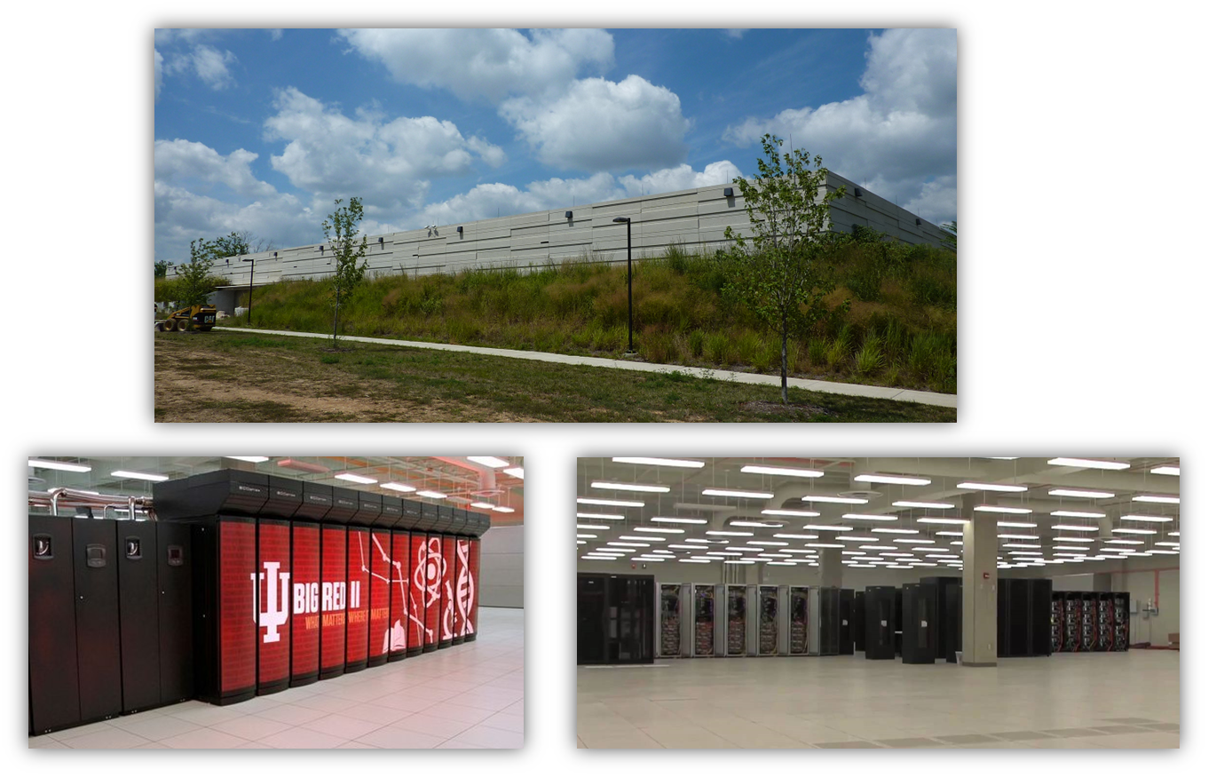
Data_center.pngData_center.png

Slide 50
HydraDAM2
IU Libraries NEH-funded collaboration with WGBH/Boston, 2015-2016
Preservation repository system for time-based media
Based on:
Fedora 4 digital repository software
Hydra framework

Slide 51
Access Repository: Avalon Media System
Co-developed by IU and Northwestern University Libraries
Funding from IMLS, 2011-2015
Funding from Mellon, 2015-2016
In production at multiple institutions
Hydra/Fedora technologies

Slide 52
Avalon at IU: Media Collections Online media.dlib.indiana.edu

Slide 53
Media Preservation at Scale:
The Indiana University Media Digitization and Preservation Initiative
Mike Casey, Director of Technical Operations, MDPI, Indiana University
Andrew Dapuzzo, Director of US Operations, Memnon Archiving Services

